Slide 1
Team 48
David Firrinicieli, Eric Limeback, Ashwin Spencer, Andrew Taylor
Real Estate Listing Price Prediction Enhanced with Income Tax Data

Slide 2
Table of Contents
Problem Overview
Approach
Progress to Date
Next Steps

Slide 3
1 - Problem Overview

Slide 4
Context & Problem Statement
CONTEXT
Predicting house price information is not a new problem, but current approaches often don’t consider the affluency of the location of the house
How might knowing various tax return fields by zip code, such as adjusted gross income, help predict the prices of homes for a given time period?
PROBLEM STATEMENT
We aim to improve list price prediction models that use traditional features about the home (house size, number of bedrooms, number of bathrooms, etc.) by exploring and testing the addition of income-tax related zip code features.
LITERATURE SURVEY
Existing attempts to incorporate zip code or location primarily focus on directly encoding the spatial data, but don’t account for affluency or income tax features

Slide 5
Research Questions & Modeling Objective
Primary Research Question
How well can we predict house prices using both standard “listing” information about the house and income tax information about the residents of a zip code?
Secondary Research Questions
How does the performance of models with income tax data added compare to those with only house features?
Which income tax features are statistically significant? What is their relationship to house price?
Which traditional features are statistically significant? What is their relationship to house price? How does the set of significant features change when income tax features are added?

Slide 6
Literature Survey
Existing attempts to incorporate zip code or location primarily focus on directly encoding the spatial data, but don’t account for affluency or income tax features
Bengaluru House Price Prediction^{[1]}
Louisville House Price Prediction^{[2]}
Modeling Goal: Develop a model for Bengaluru housing that predicts price from a number of features, primarily listing-specific
Differences to our approach:
Does not incorporate affluency data
One-hot encodes the markets
Modeling Goal: Test a number of approaches to predict price in Louisville, KY, including encoding the submarket and creating spatial features such as distance from a central point
Differences to our approach:
Does not incorporate affluency data
Directly encodes spatial data
[1] “Machine Learning based Predicting House Prices using Regression Techniques”; J Manasa, Radha Guota, N S Narahari; https://ieeexplore.ieee.org/abstract/document/9074952
[2] “Predicting House Prices with Spatial Dependence: A Comparison of Alternative Methods”; Steven Bourassa, Eva Cantoni, & Martin Hoesli; https://www.tandfonline.com/doi/abs/10.1080/10835547.2010.12091276

Slide 7
2 - Approach

Slide 8
Planned Methodology
Data Cleansing & Transformation
Exploratory Data Analysis
Model Development & Selection
Results Evaluation
Create the dataset to feed EDA and the model
Summarize and explore before modeling
Test and select the best model
Interpret models to answer key questions
Perform null and duplicate checks
Confirm data types
Aggregate data as-needed
Join the real estate and income tax datasets and checking join veracity
Create calculated fields for our variables as needed
Develop univariate summaries (histograms, boxplots)
Understand dependent-independent variable summaries (pair plots, correlation heatmaps)
Correlation analysis
Split data into training/testing
Preprocess data (scaling, PCA)
Select and engineer features as-needed
Train and score models from different families
Select a ‘best’ model type, and fit that model on the final data
Evaluate model performance metrics to validate results and understand the predictive power of our model
Compare models with and without income tax data
Develop conclusions

Slide 9
3 - Progress to Date

Slide 10
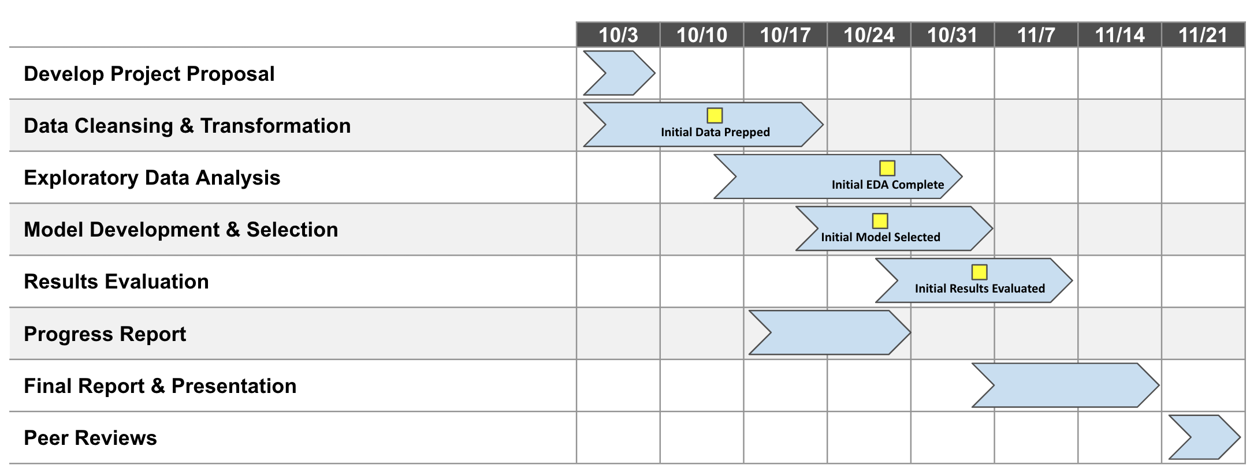
Status Overview
The team has completed data cleansing & transformation, an initial pass at EDA, and begun model development & selection.
We’re on track to have modeling complete in two weeks, allowing an additional week to iterate as-needed and develop our final report

Slide 11
Data Cleansing and Transformation
To this point, we have completed data extraction, cleaning, and merging, although discoveries during model development may cause us to revisit this step (e.g. creating interaction terms).
Steps Taken
Feature | Description
bed | Number of bedrooms on the listing
bath | Number of bathrooms on the listing
acre_lot | Size of the lot, in acres
house_size | Size of the house, in sq ft
state | State
total_credit_amt | Total tax credits amount per return
taxable_income_amt | Taxable income amount per return
mortgageint_amt | Mortgage interest paid amount per return
p_mortgageint_nr | Proportion of returns with mortgage interest paid
inctax_amt | Income tax amount per return
p_unemploy_nr | Proportion of returns with unemployment
agi_amt | Adjust gross income (AGI) [2]
num_dependents | Number of dependents per return
p_re_taxes_nr | Number of returns with real estate taxes
Downloaded and explored data
Understood column meanings and selected initial feature list from income tax data
Filtered to time window
Removed duplicate rows from real estate data
Corrected zip code field
Aggregated income tax data
Joined the real estate and income tax datasets
Began null cleansing

Slide 12
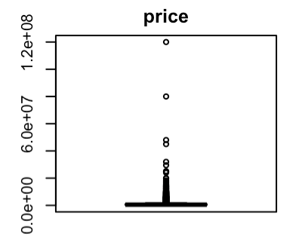
Exploratory Data Analysis
We have completed an initial pass at EDA for the model, ignoring real estate features for now as we determine how to handle nulls in the bed, bath, acre_lot, and house_size fields.
Steps Taken
Observations
Performed univariate analysis to explore distributions and outliers
Investigated feature/DV relatioships using pairplots and correlation
Evaluated multicollinearity between predictors using a correlation heatmap
Univariate analysis revealed outliers in the price field which we will further investigate
Investigation of correlation between price and income tax features reveals limited linear signal
Evaluation of multicollinearity showed many places with correlation between predictors
INITIAL HYPOTHESES
Real estate features are expected to provide the most signal to the model
Tax features related to affluency have the most potential to provide signal to the model
Tree-based models will likely far outperform linear models

Slide 13
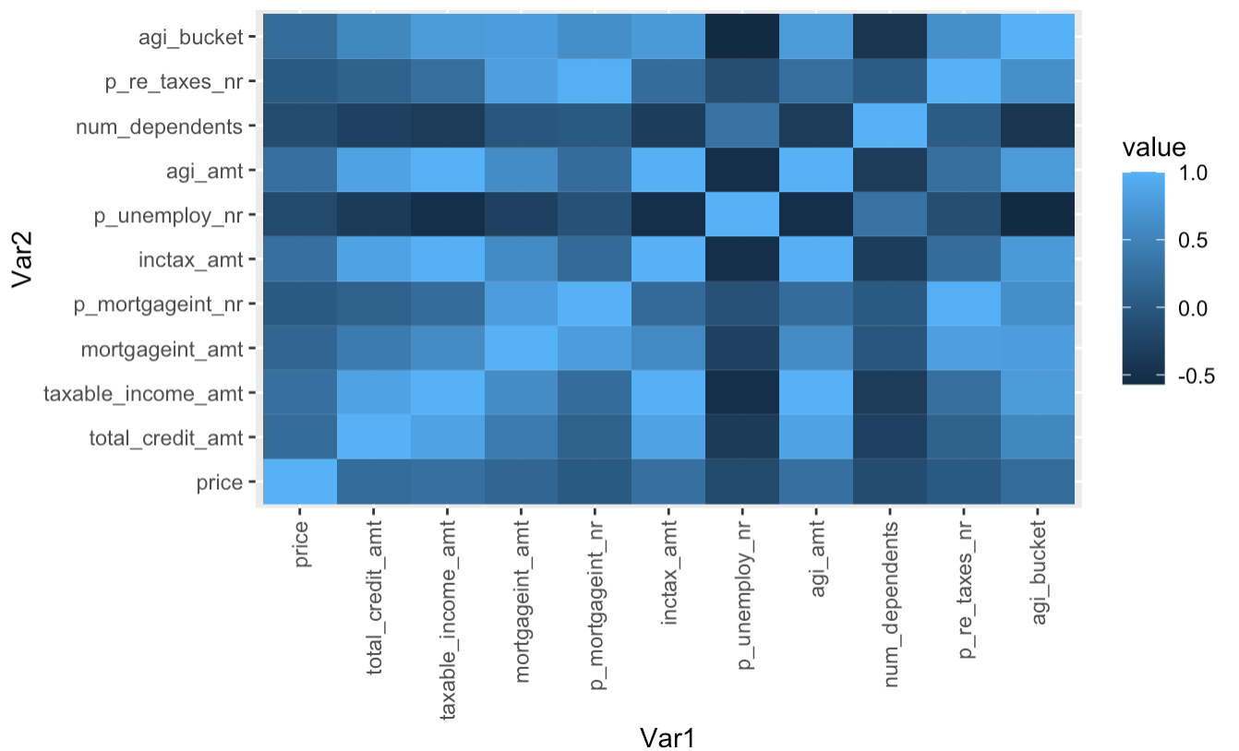
Exploratory Data Analysis - Detail
Feature | Correlation with Price
total_credit_amt | 0.215
taxable_income_amt | 0.292
mortgageint_amt | 0.174
p_mortgageint_nr | 0.020
inctax_amt | 0.292
p_unemploy_nr | -0.176
agi_amt | 0.288
num_dependents | -0.144
p_re_taxes_nr | 0.032
agi_bucket | 0.219
Univariate analysis revealed outliers in the price field which we will further investigate
Investigation of correlation between price and income tax features reveals limited linear signal
Evaluation of multicollinearity showed correlation between predictors, particularly in the income tax dataset

Slide 14
Model Development & Selection
We have built out a skeleton of the model development and selection
Steps Taken
Evaluation Framework
Split into train-test data
Train each model type & collect predictions
Preprocess (scale/standard > PCA)
Tune hyperparameters
Fit
Predict
Compare performance of models
For best model type, compare performance to a model without income tax features
Identified models that we want to test
Developed a rough R framework for modeling
Model Types
Multiple linear regression
LASSO regression
Random Forest
Boosting

Slide 15



Lessons Learned & Challenges
Understanding the meaning of different columns can be challenging
Digging through Kaggle comments, finding true sources of data from the government, and looking up citations were critical in appropriately interpreting fields
Working with the varying levels of detail in the data can lead to calculation errors
Rolling up the income tax data from the zip code-AGI bucket made our selection of aggregation math very important – after evaluating median, arithmetic mean, total, and weighted average, we settled on using the total amounts
Cleansing null values all presented their own unique challenges
Sporadic null values in the data has forced us to make decisions (some ongoing) about whether to impute or remove – as of now, we’ve removed 30 records with nulls in all income tax fields and are determining the best path forward for the nulls in the real estate features

Slide 16
Next Steps

Slide 17
Next Steps
Finish EDA
Make final decision on null values
Rerun analysis with real estate features
Complete model development and selection
Build out PCA and tree-based model code
Run models, compare performance, and select the best
Run a final version of the best model type without income tax features
Evaluate outputs
Examine performance of all models to understand overall predictive power
Compare performance of model with and without income tax features to understand their additive predictive power

Slide 18
Literature Citations
[1] “Machine Learning based Predicting House Prices using Regression Techniques”; J Manasa, Radha Guota, N S Narahari; https://ieeexplore.ieee.org/abstract/document/9074952
[2] “Predicting House Prices with Spatial Dependence: A Comparison of Alternative Methods”; Steven Bourassa, Eva Cantoni, & Martin Hoesli; https://www.tandfonline.com/doi/abs/10.1080/10835547.2010.12091276

